Slide 1
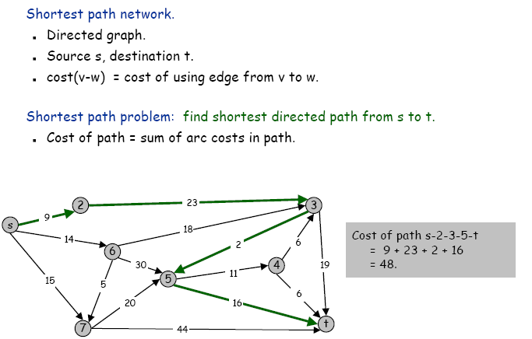
Shortest path problems

Slide 2
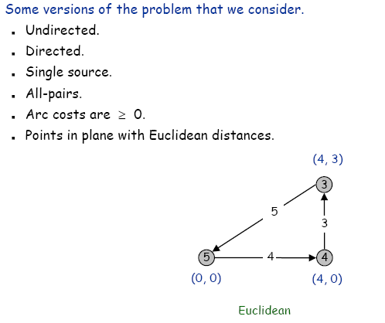
Shortest path problems

Slide 3
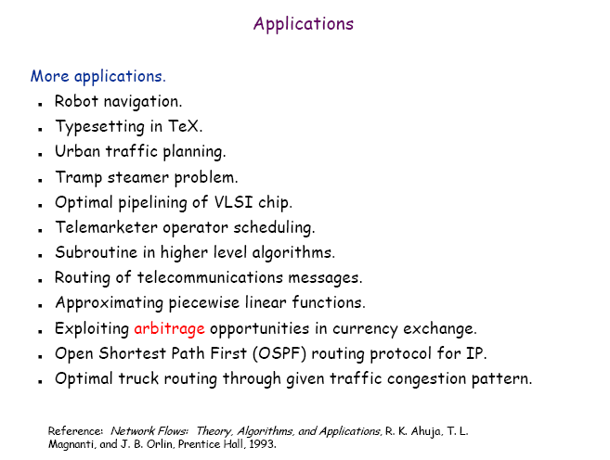
Shortest path problems

Slide 4
Single-Source Shortest Paths
Given graph (directed or undirected) G = (V,E) with
weight function w: E → R and a vertex s∈V,
find for all vertices v∈V the minimum possible weight for
path from s to v.
We will discuss two general case algorithms:
Dijkstra's (positive edge weights only)
Bellman-Ford (positive end negative edge weights)
If all edge weights are equal (let's say 1), the problem
is solved by BFS in Θ(V+E) time.

Slide 5
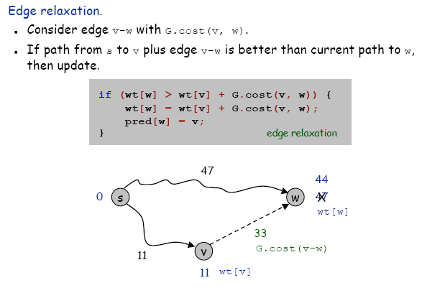
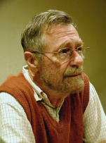

Dijkstra’s Algorithm - Relax
Relax(vertex u, vertex v, weight w)
if d[v] > d[u] + w(u,v) then
d[v] ← d[u] + w(u,v)
p[v] ← u

Slide 6
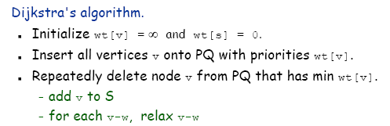
Dijkstra’s Algorithm - Idea

Slide 7
Dijkstra’s Algorithm - SSSP-Dijkstra
SSSP-Dijkstra(graph (G,w), vertex s)
InitializeSingleSource(G, s)
S ← ∅
Q ← V[G]
while Q ≠ 0 do
u ← ExtractMin(Q)
S ← S ∪ {u}
for v ∈ Adj[u] do
Relax(u,v,w)
InitializeSingleSource(graph G, vertex s)
for v ∈ V[G] do
d[v] ← ∞
p[v] ← 0
d[s] ← 0

Slide 8
Dijkstra’s Algorithm - Example
1
10
2
3
9
4
6
5
7
2

Slide 9
Dijkstra’s Algorithm - Example
1
∞
∞
10
2
3
9
0
4
6
5
7
∞
∞
2

Slide 10
Dijkstra’s Algorithm - Example
1
10
∞
10
2
3
9
0
4
6
5
7
5
∞
2

Slide 11
Dijkstra’s Algorithm - Example
1
10
∞
10
2
3
9
0
4
6
5
7
5
∞
2

Slide 12
Dijkstra’s Algorithm - Example
1
8
14
10
2
3
9
0
4
6
5
7
5
7
2

Slide 13
Dijkstra’s Algorithm - Example
1
8
14
10
2
3
9
0
4
6
5
7
5
7
2

Slide 14
Dijkstra’s Algorithm - Example
1
8
13
10
2
3
9
0
4
6
5
7
5
7
2

Slide 15
Dijkstra’s Algorithm - Example
1
8
13
10
2
3
9
0
4
6
5
7
5
7
2

Slide 16
Dijkstra’s Algorithm - Example
1
8
9
10
2
3
9
0
4
6
5
7
5
7
2

Slide 17
Dijkstra’s Algorithm - Example
1
8
9
10
2
3
9
0
4
6
5
7
5
7
2

Slide 18
Dijkstra’s Algorithm - Complexity
SSSP-Dijkstra(graph (G,w), vertex s)
InitializeSingleSource(G, s)
S ← ∅
Q ← V[G]
while Q ≠ 0 do
u ← ExtractMin(Q)
S ← S ∪ {u}
for u ∈ Adj[u] do
Relax(u,v,w)
executed Θ(V) times
Θ(E) times in total
InitializeSingleSource(graph G, vertex s)
for v ∈ V[G] do
d[v] ← ∞
p[v] ← 0
d[s] ← 0
Θ(V)
Relax(vertex u, vertex v, weight w)
if d[v] > d[u] + w(u,v) then
d[v] ← d[u] + w(u,v)
p[v] ← u
Θ(1) ?

Slide 19
Dijkstra’s Algorithm - Complexity
InitializeSingleSource T_{I}(V,E) = Θ(V)
Relax T_{R}(V,E) = Θ(1)?
SSSP-Dijkstra
T(V,E) = T_{I}(V,E) + Θ(V) + V Θ(log V) + E T_{R}(V,E) =
= Θ(V) + Θ(V) + V Θ(log V) + E Θ(1) = Θ(E + V log V)

Slide 20
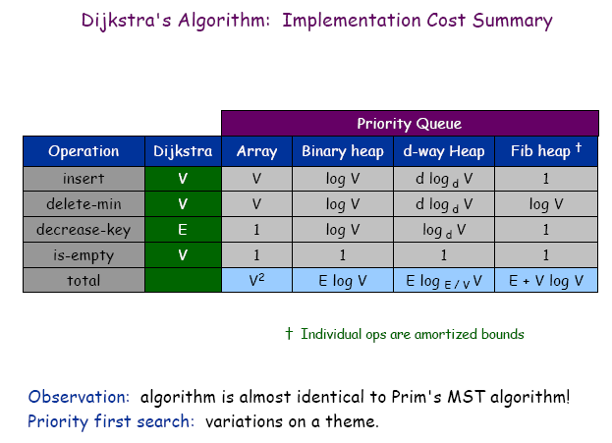
Dijkstra’s Algorithm - Complexity

Slide 21
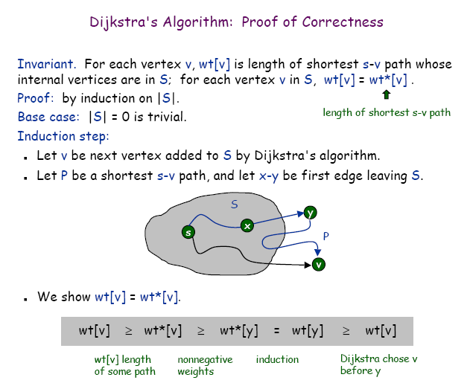
Dijkstra’s Algorithm - Correctness

Slide 22
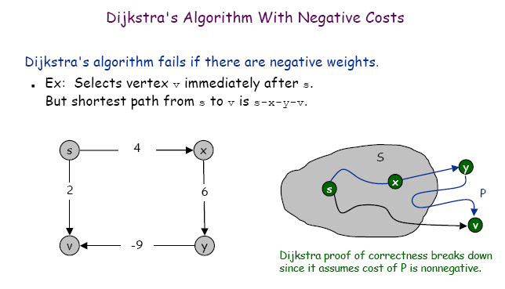
Dijkstra’s Algorithm - negative weights?

Slide 23
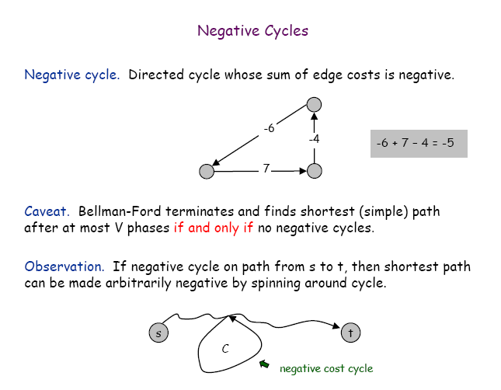
Bellman-Ford Algorithm - negative cycles?

Slide 24
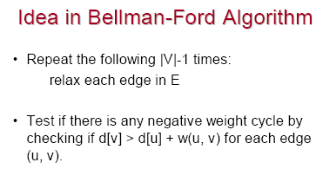
Bellman-Ford Algorithm - Idea

Slide 25
Bellman-Ford Algorithm - SSSP-BellmanFord
SSSP-BellmanFord(graph (G,w), vertex s)
InitializeSingleSource(G, s)
for i ← 1 to |V[G] − 1| do
for (u,v) ∈ E[G] do
Relax(u,v,w)
for (u,v) ∈ E[G] do
if d[v] > d[u] + w(u,v) then
return false
return true

Slide 26
Bellman-Ford Algorithm - Example
-2
5
6
-3
8
-4
7
7
2
9

Slide 27
Bellman-Ford Algorithm - Example
-2
∞
5
∞
6
-3
8
0
7
-4
7
2
∞
9
∞

Slide 28
Bellman-Ford Algorithm - Example
-2
6
5
∞
6
-3
8
0
7
-4
7
2
7
9
∞

Slide 29
Bellman-Ford Algorithm - Example
-2
6
5
4
6
-3
8
0
7
-4
7
2
7
9
2

Slide 30
Bellman-Ford Algorithm - Example
-2
2
5
4
6
-3
8
0
7
-4
7
2
7
9
2

Slide 31
Bellman-Ford Algorithm - Example
-2
2
5
4
6
-3
8
0
7
-4
7
2
7
9
-2

Slide 32
Bellman-Ford Algorithm - Complexity
SSSP-BellmanFord(graph (G,w), vertex s)
InitializeSingleSource(G, s)
for i ← 1 to |V[G] − 1| do
for (u,v) ∈ E[G] do
Relax(u,v,w)
for (u,v) ∈ E[G] do
if d[v] > d[u] + w(u,v) then
return false
return true
executed Θ(V) times
Θ(E)
Θ(1)
Θ(E)

Slide 33
Bellman-Ford Algorithm - Complexity
InitializeSingleSource T_{I}(V,E) = Θ(V)
Relax T_{R}(V,E) = Θ(1)?
SSSP-BellmanFord
T(V,E) = T_{I}(V,E) + V E T_{R}(V,E) + E =
= Θ(V) + V E Θ(1) + E =
= Θ(V E)

Slide 34
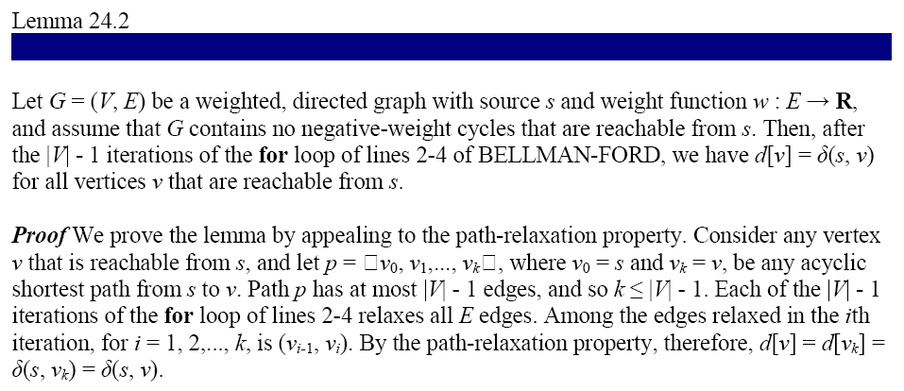
Bellman-Ford Algorithm - Correctness

Slide 35
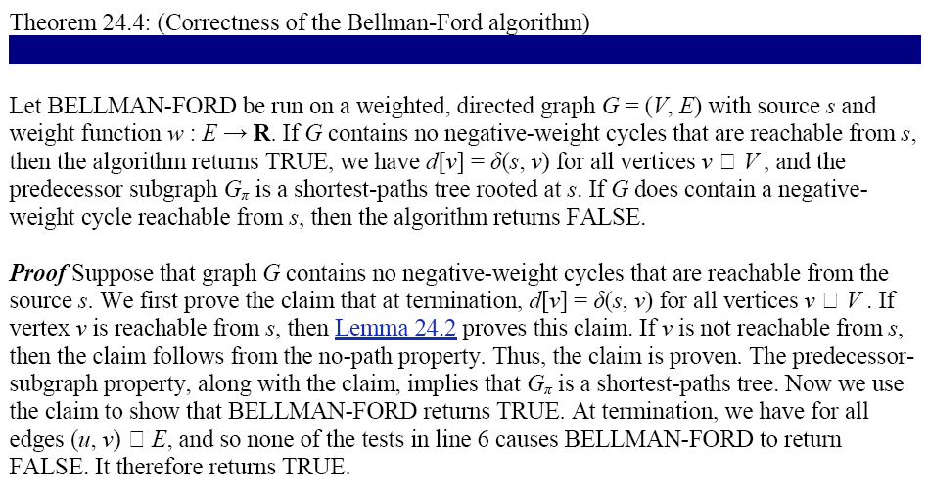
Bellman-Ford Algorithm - Correctness

Slide 36
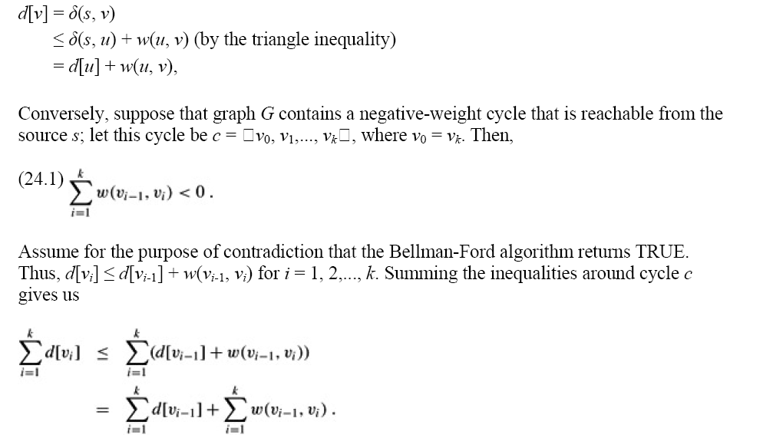
Bellman-Ford Algorithm - Correctness

Slide 37
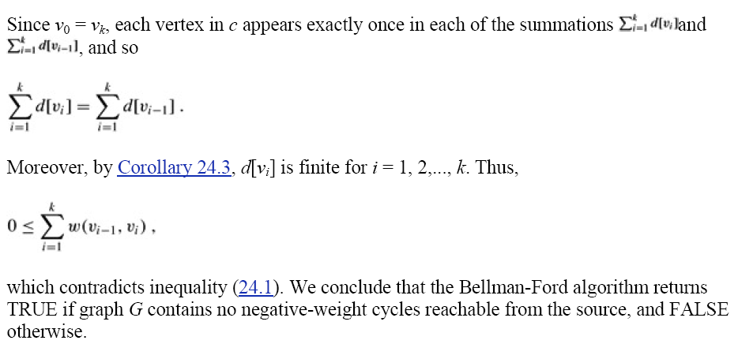
Bellman-Ford Algorithm - Correctness

Slide 38
Shortest Paths in DAGs - SSSP-DAG
SSSP-DAG(graph (G,w), vertex s)
topologically sort vertices of G
InitializeSingleSource(G, s)
for each vertex u taken in topologically sorted order do
for each vertex v ∈ Adj[u] do
Relax(u,v,w)

Slide 39
Shortest Paths in DAGs - Example
6
1
5
2
7
-1
-2
4
3
2

Slide 40
Shortest Paths in DAGs - Example
6
1
5
2
7
-1
-2
∞
0
∞
∞
∞
∞
4
3
2

Slide 41
Shortest Paths in DAGs - Example
6
1
5
2
7
-1
-2
∞
0
∞
∞
∞
∞
4
3
2

Slide 42
Shortest Paths in DAGs - Example
6
1
5
2
7
-1
-2
∞
0
∞
∞
∞
∞
4
3
2

Slide 43
Shortest Paths in DAGs - Example
6
1
5
2
7
-1
-2
∞
0
2
6
∞
∞
4
3
2

Slide 44
Shortest Paths in DAGs - Example
6
1
5
2
7
-1
-2
∞
0
2
6
6
4
4
3
2

Slide 45
Shortest Paths in DAGs - Example
6
1
5
2
7
-1
-2
∞
0
2
6
6
4
4
3
2

Slide 46
Shortest Paths in DAGs - Example
6
1
5
2
7
-1
-2
∞
0
2
6
5
4
4
3
2

Slide 47
Shortest Paths in DAGs - Example
6
1
5
2
7
-1
-2
∞
0
2
6
5
4
4
3
2

Slide 48
Shortest Paths in DAGs - Example
6
1
5
2
7
-1
-2
∞
0
2
6
5
3
4
3
2

Slide 49
Shortest Paths in DAGs - Example
6
1
5
2
7
-1
-2
∞
0
2
6
5
3
4
3
2

Slide 50
Shortest Paths in DAGs - Complexity
SSSP-DAG(graph (G,w), vertex s)
topologically sort vertices of G
InitializeSingleSource(G, s)
for each vertex u taken in topologically sorted order do
for each vertex v ∈ Adj[u] do
Relax(u,v,w)
T(V,E) = Θ(V + E) + Θ(V) + Θ(V) + E Θ(1) = Θ(V + E)

Slide 51
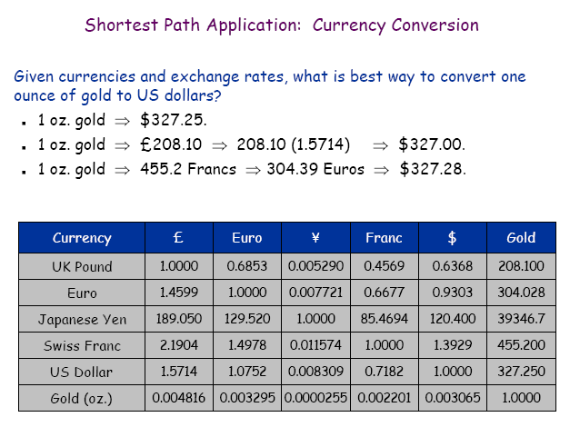
Application of SSSP - currency conversion

Slide 52
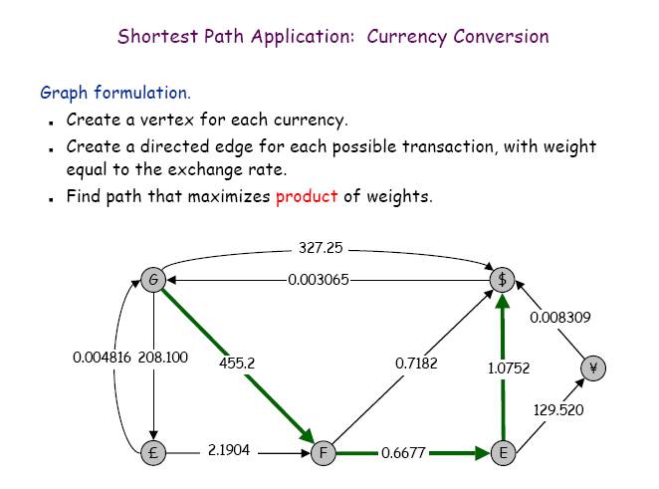
Application of SSSP - currency conversion

Slide 53
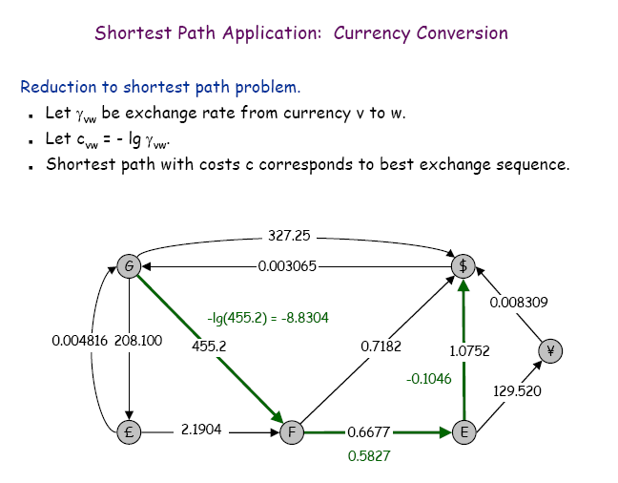
Application of SSSP - currency conversion

Slide 54
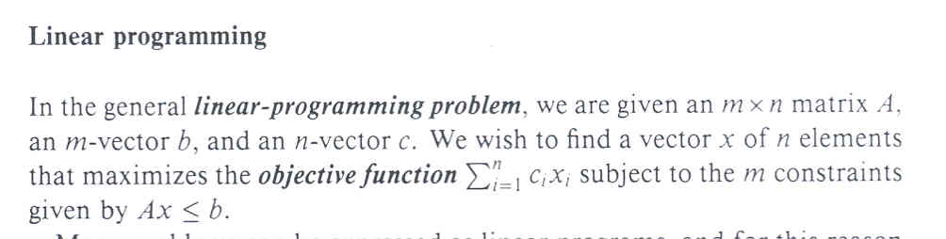
Application of SSSP - constraint satisfaction

Slide 55
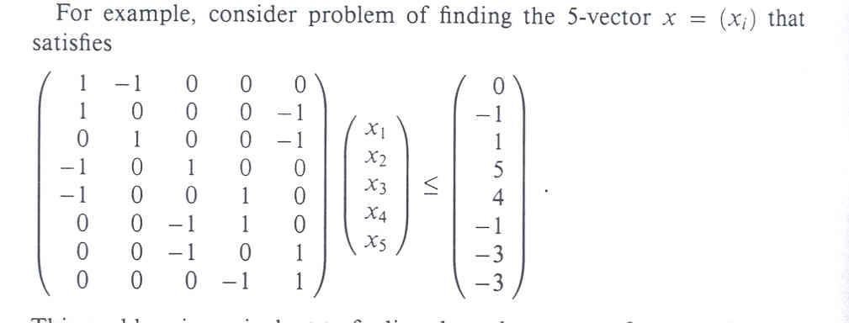
Application of SSSP - constraint satisfaction

Slide 56
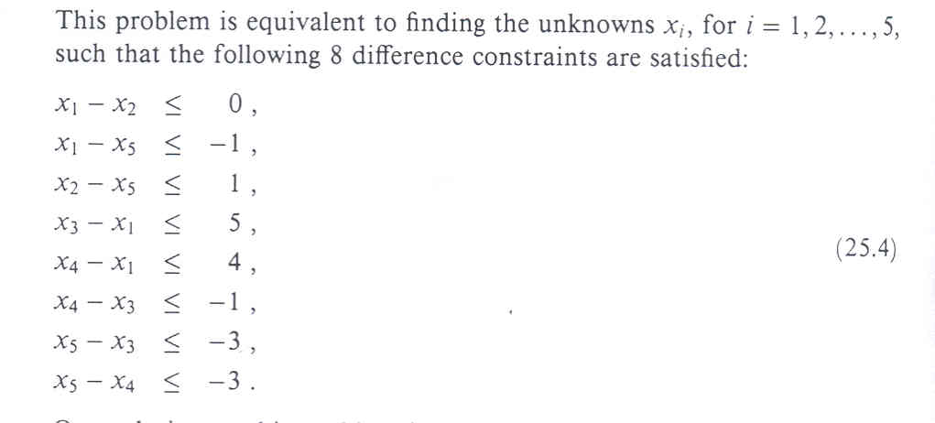
Application of SSSP - constraint satisfaction

Slide 57
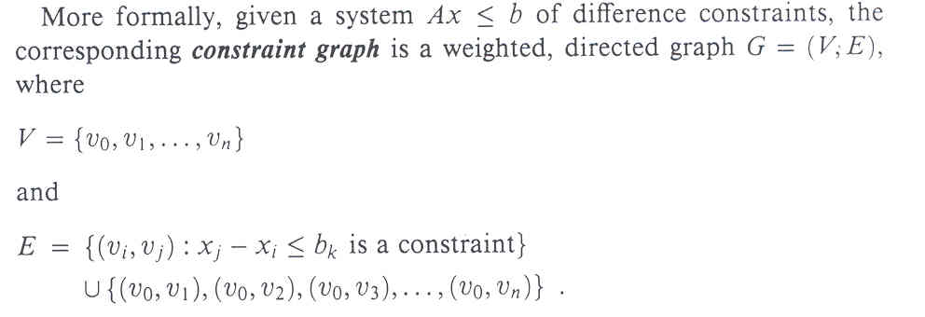
Application of SSSP - constraint satisfaction

Slide 58
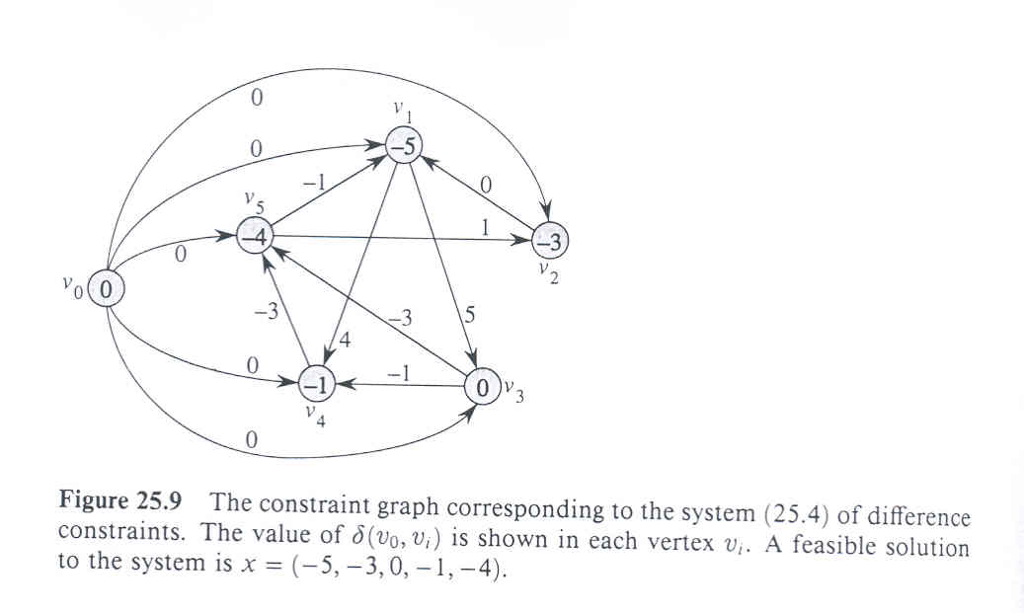
Application of SSSP - constraint satisfaction

Slide 59
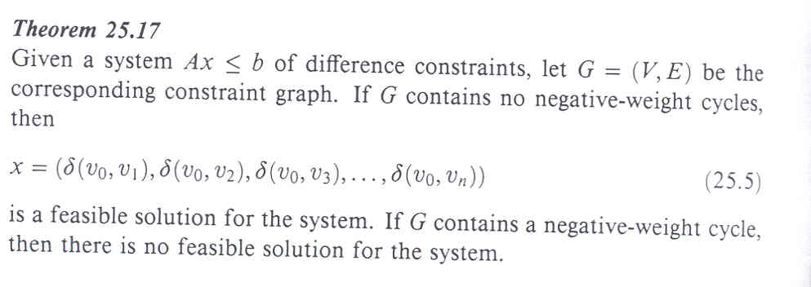
Application of SSSP - constraint satisfaction

Slide 60
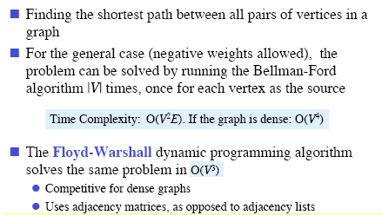
All-Pairs Shortest Paths
Given graph (directed or undirected) G = (V,E) with
weight function w: E → R find for all pairs of vertices
u,v ∈ V the minimum possible weight for path from u to v.

Slide 61
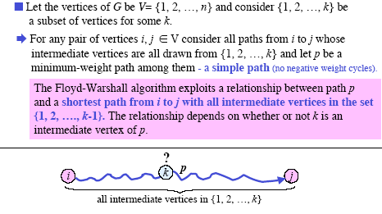
Floyd-Warshall Algorithm - Idea

Slide 62
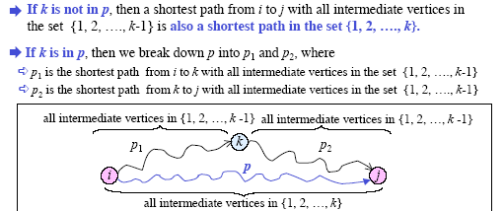
Floyd-Warshall Algorithm - Idea

Slide 63
Floyd-Warshall Algorithm - Idea
d_{s,t}^{(i)} – the shortest path from s to t containing only vertices
v₁, ..., v_{i}
d_{s,t}⁽⁰⁾ = w(s,t)
w(s,t) if k = 0
min{d_{s,t}^{(k-1)}, d_{s,k}^{(k-1)} + d_{k,t}^{(k-1)}} if k > 0
d_{s,t}^{(k)} =

Slide 64
Floyd-Warshall Algorithm - Algorithm
FloydWarshall(matrix W, integer n)
for k ← 1 to n do
for i ← 1 to n do
for j ← 1 to n do
d_{ij}^{(k)} ← min(d_{ij}^{(k-1)}, d_{ik}^{(k-1)} + d_{kj}^{(k-1)})
return D^{(n)}

Slide 65
Floyd-Warshall Algorithm - Example
W
3
2
4
7
1
0 | 3 | 8 | ∞ | -4
∞ | 0 | ∞ | 1 | 7
∞ | 4 | 0 | ∞ | ∞
2 | ∞ | -5 | 0 | ∞
∞ | ∞ | ∞ | 6 | 0
1
3
8
-4
2
-5
5
4
6

Slide 66
Floyd-Warshall Algorithm - Example
D⁽⁰⁾ Π⁽⁰⁾
0 | 3 | 8 | ∞ | -4
∞ | 0 | ∞ | 1 | 7
∞ | 4 | 0 | ∞ | ∞
2 | ∞ | -5 | 0 | ∞
∞ | ∞ | ∞ | 6 | 0
0 | 0 | 0 |  | 0
 | 0 |  | 0 | 0
 | 0 | 0
0 |  | 0 | 0
 |  |  | 0 | 0

Slide 67
Floyd-Warshall Algorithm - Example
D⁽¹⁾ Π⁽¹⁾
0 | 3 | 8 | ∞ | -4
∞ | 0 | ∞ | 1 | 7
∞ | 4 | 0 | ∞ | ∞
2 | 5 | -5 | 0 | -2
∞ | ∞ | ∞ | 6 | 0
0 | 0 | 0 |  | 0
 | 0 |  | 0 | 0
 | 0 | 0
0 | 1 | 0 | 0 | 1
 |  |  | 0 | 0

Slide 68
Floyd-Warshall Algorithm - Example
D⁽²⁾ Π⁽²⁾
0 | 3 | 8 | 4 | -4
∞ | 0 | ∞ | 1 | 7
∞ | 4 | 0 | 5 | 11
2 | 5 | -5 | 0 | -2
∞ | ∞ | ∞ | 6 | 0
0 | 0 | 0 | 2 | 0
 | 0 |  | 0 | 0
 | 0 | 0 | 2 | 2
0 | 1 | 0 | 0 | 1
 |  |  | 0 | 0

Slide 69
Floyd-Warshall Algorithm - Example
D⁽³⁾ Π⁽³⁾
0 | 3 | 8 | 4 | -4
∞ | 0 | ∞ | 1 | 7
∞ | 4 | 0 | 5 | 11
2 | -1 | -5 | 0 | -2
∞ | ∞ | ∞ | 6 | 0
0 | 0 | 0 | 2 | 0
 | 0 |  | 0 | 0
 | 0 | 0 | 2 | 2
0 | 3 | 0 | 0 | 1
 |  |  | 0 | 0

Slide 70
Floyd-Warshall Algorithm - Example
D⁽⁴⁾ Π⁽⁴⁾
0 | 3 | -1 | 4 | -4
3 | 0 | -4 | 1 | -1
7 | 4 | 0 | 5 | 3
2 | -1 | -5 | 0 | -2
8 | 5 | 1 | 6 | 0
0 | 0 | 4 | 2 | 0
4 | 0 | 4 | 0 | 1
4 | 0 | 0 | 2 | 1
0 | 3 | 0 | 0 | 1
4 | 3 | 4 | 0 | 0

Slide 71
Floyd-Warshall Algorithm - Example
D⁽⁵⁾ Π⁽⁵⁾
0 | 3 | -1 | 2 | -4
3 | 0 | -4 | 1 | -1
7 | 4 | 0 | 5 | 3
2 | -1 | -5 | 0 | -2
8 | 5 | 1 | 6 | 0
0 | 0 | 4 | 5 | 0
4 | 0 | 4 | 0 | 1
4 | 0 | 0 | 2 | 1
0 | 3 | 0 | 0 | 1
4 | 3 | 4 | 0 | 0

Slide 72
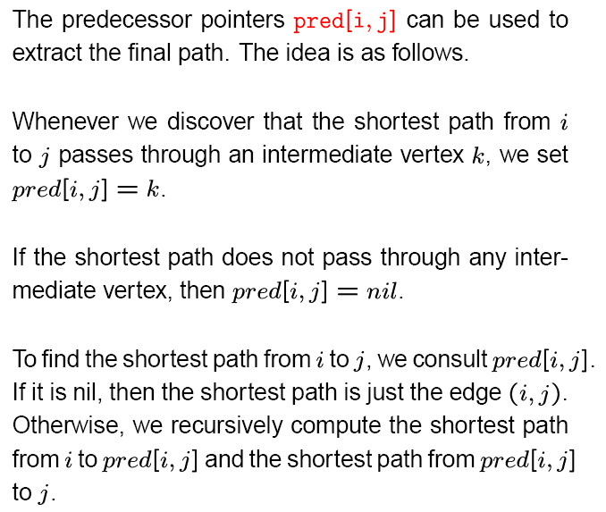
Floyd-Warshall Algorithm - Extracting the shortest paths

Slide 73
Floyd-Warshall Algorithm - Complexity
FloydWarshall(matrix W, integer n)
for k ← 1 to n do
for i ← 1 to n do
for j ← 1 to n do
d_{ij}^{(k)} ← min(d_{ij}^{(k-1)}, d_{ik}^{(k-1)} + d_{kj}^{(k-1)})
return D^{(n)}
3 for cycles, each executed exactly n times
T(V,E) = Θ(n³) = Θ(V³)

Slide 74
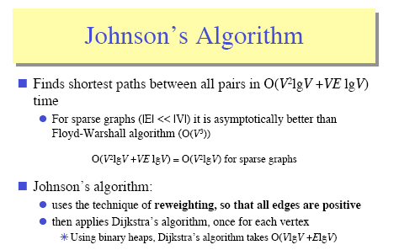
All-Pairs Shortest Paths -Johnson's algorithm

Slide 75
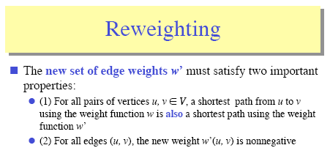
All-Pairs Shortest Paths - Reweighting

Slide 76
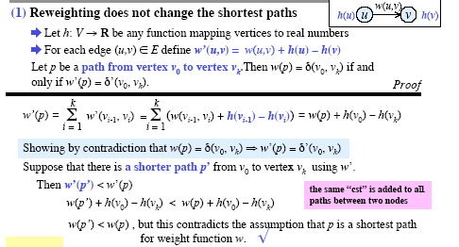
All-Pairs Shortest Paths - Reweighting

Slide 77

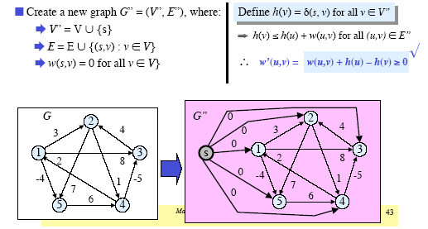
All-Pairs Shortest Paths - Reweighting

